Slide 1
Accessible Medical Diagnostic Equipment & Prescription Drug Container Labels
Pacific ADA Center webinar
3/26/2020

Slide 2
Agenda
Medical Diagnostic Equipment
Background
Ch 1: Application
Ch 2: Scoping
Ch 3: Technical requirements
Prescription drug containers

Slide 3
Medical Diagnostic Equipment

Slide 4
Background

Slide 5
Existing Standards
ADA and ABA Accessibility Guidelines
ANSI/AAMI HE75 – 2009 Human Factors Engineering – Design of Medical Devices
RERC on Accessible Medical Instrumentation
Research Data
Notes:
(RERC) Rehabilitation Engineering Research Center on Accessible Medical Instrumentation

Slide 6
Accessibility challenge
Reports of:
Moderately difficult/impossible to use
Examination tables – 75%
X-ray equipment – 68%
Weight scales – 53%
Examination chairs – 50%
Accessible Medical Instrumentation RERC usability survey
Survey reported usability of various medical diagnostic equipment
Significant percent of respondents reported equipment was moderately difficult to impossible to use
Notes:
Rehabilitation Engineering Research Center on Accessible Medical Instrumentation

Slide 7
Rehabilitation Act §510
Mandates the Access Board to issue minimum technical criteria for accessible medical diagnostic equipment in consultation with FDA
Affordable Care Act amends the Rehabilitation Act to address access to MDE
(March 23, 2010)

Slide 8
Rehabilitation Act §510
Specifically addresses equipment in:
Physicians offices, clinics, emergency rooms, hospitals, other medical settings. Includes optometrists and dentists
Scoping to be determined in appropriate regulatory or administrative context
Final Standards are voluntary until adopted by an enforcing Agency e.g., DOJ for the Americans with Disabilities Act
Could be used by FDA to verify labelling claims
Can be voluntarily adopted through policy

Slide 9
Federal Partners
Health and Human Services
US Food and Drug Administration
Department of Justice
Disability Rights Section
Department of Veterans Affairs

Slide 10
Standards for Accessible Medical Diagnostic Equipment
Chapter 1: Application and Administration
M101 General
M102 Definitions
Chapter 2: Scoping
M201 General
Chapter 3: Technical Requirements
M301 Diagnostic Equipment Used by Patients in Supine, Prone, or Side-Lying Position
M302 Diagnostic Equipment Used by Patients in Seated Position
M303 Diagnostic Equipment Used by Patients Seated in a Wheelchair
M304 Diagnostic Equipment Used by Patients in Standing Position
M305 Supports
M306 Communication
M307 Operable Parts
Published in:
Code of Federal Regulations, Title 36, §1195.1 Standards, Appendix to Part 1195
Found on our website
www.access-board.gov

Slide 11
MDE Standards
Do not address the accessibility of existing diagnostic equipment
Do not require a percentage of new or replacement equipment to be accessible

Slide 12
Chapter 1: Application and Administration

Slide 13
Application
Provide for independent access and use of diagnostic equipment to the maximum extent possible
Applies to new diagnostic equipment, based on the patient positions that the equipment supports, during patient transfer and diagnostic use
Communication features or operable parts – where provided for patient use
Purpose:
To ensure accessibility to, and usability of the diagnostic equipment by patients with disabilities.

Slide 14
“Diagnostic equipment” Includes:
Examination tables
Examination chairs (including those used for dental or optical exams)
Weight scales
Radiological equipment
X-ray machines
MRI, CT Scan
Mammography equipment
Other MDE

Slide 15
“Diagnostic equipment” Does not include:
Personal devices
Blood glucose monitors
Positioning aids
Wedges
Surgical and medical instruments
Stethoscopes
Forceps, scalpels

Slide 16
Equivalent facilitation
The use of alternative designs or technologies that result in substantially equivalent or greater accessibility and usability than specified in the MDE Standards is permitted.
MDE language is different than 2010 ADA

Slide 17
Measurements and Dimensions
Based on Adult Dimensions and Anthropometrics
Use of MDE by children is not addressed in these standards
Dimensions not stated as maximum or minimum are absolute
Subject to conventional industry tolerances
Measured in US or metric units, independently

Slide 18
Definitions
Defined in section M102.1:
End Transfer Surface
Enforcing Authority
Examination Chair
Imaging Bed
Imaging Equipment with Bores
Medical Diagnostic Equipment (Diagnostic Equipment)
Operable Parts
Side Transfer Surface
Transfer Surface
Defined in regulations or policies issued by enforcing authority
Undefined terms:
Not defined in M102.1 or in regulations or policies issued by an enforcing authority:
Ordinarily accepted meaning in the sense that the context implies.

Slide 19
Chapter 2: Scoping

Slide 20
M201 General
Scoping to be determined by enforcing authority
Potential enforcing authorities could include DOJ, HHS, or adoption through policy (like select VAs)
General exception:
“rare circumstances where compliance would alter diagnostically required structural or operational characteristics of the equipment and would prevent the use of the equipment for its intended diagnostic purpose”
Diagnostic equipment shall comply to the maximum extent practicable

Slide 21
Chapter 3: Technical Requirements

Slide 22
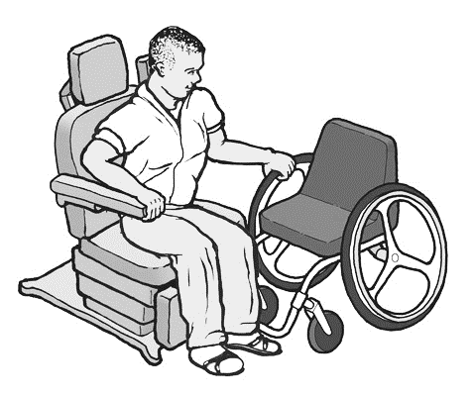
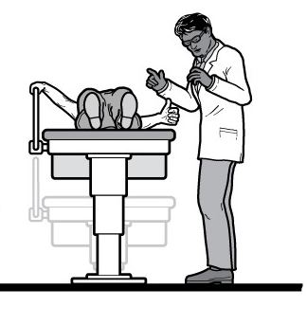
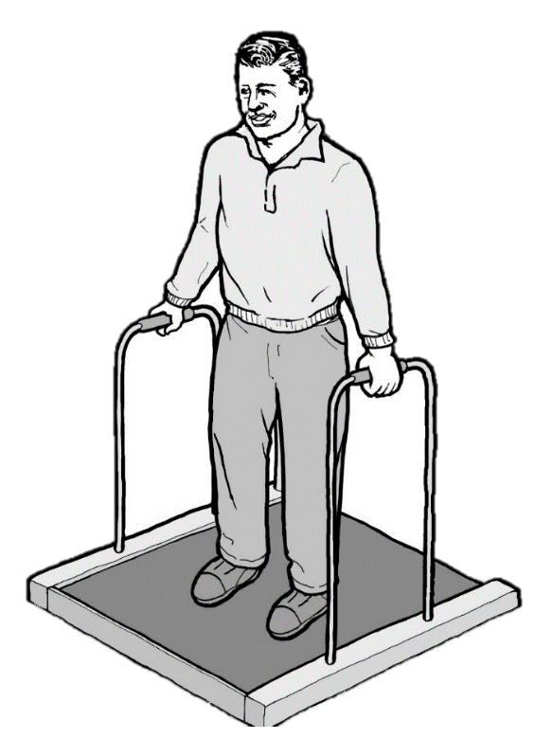
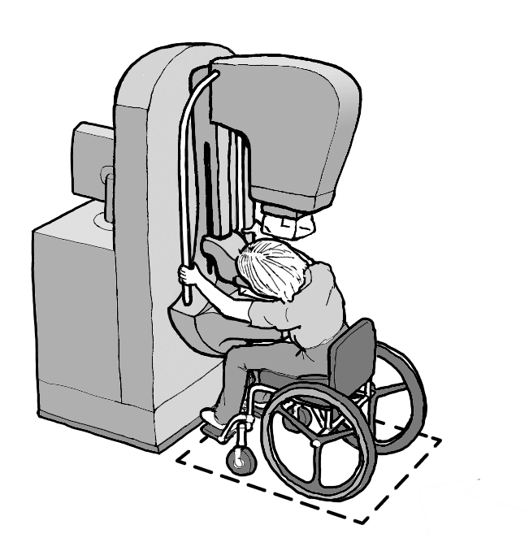
Chapter 3
Supine, prone, or side-lying positions (M301)
Seated position (M302)
Seated in a wheelchair (M303)
Standing position (M304)
Supports (M305)
Communication (M306)
Operable parts (M307)

Slide 23
Chapter 3
Supine, prone, or side-lying positions (M301)
Seated position (M302)
Seated in a wheelchair (M303)
Standing position (M304)
Supports (M305)
Communication (M306)
Operable parts (M307)

Slide 24
Supine, Prone, or Side-Lying Position (M301)
Includes:
MRI, CT scan
Examination tables
Hospital stretcher
Does not include:
Examination chairs that recline (covered in M302)

Slide 25
Supine, Prone, or Side-Lying Position (M301)
Transfer surface
Height adjustable
Size
End transfer surface
Side transfer surface
Unobstructed transfer
Supports
Transfer supports
Leg supports, where provided
Head and back support
Lift compatibility
Clearance in base
Clearance around base
Exception: overhead lifts

Slide 26
Transfer surface
Height adjustable
Measured from floor to top of uncompressed transfer surface
High transfer position at 25 inches minimum
Low transfer position of (17-19 inches) maximum
At least 4 additional transfer positions located between the low and high, separated by 1 inch minimum

Slide 27
Transfer surface
Low position sunset clause
Low transfer position height (17” – 19”) expires in 5 years (January 9, 2022)
Research to be done on transfer heights

Slide 28
Transfer surface
End Transfer Surface
Located at one end of an examination surface that allows transfer at the end and one adjoining side
Side Transfer Surface
Located within the length of the examination surface that allows transfer on two opposing sides

Slide 29
Transfer surface
Size
Comply with either:
End Transfer
17” x 28” min
Side Transfer
28” x 28” min
Measured from center points of their opposing sides

Slide 30
Transfer surface
Size: Exception
Imaging equipment with bores
Width: 21” min
Not less than the full width of the examination surface provided

Slide 31
Transfer surface
Unobstructed transfer
Each transfer surface shall provide two unobstructed sides for patient transfer
Side transfer = L side + R side
End transfer = end + (L/R) side

Slide 32
Transfer surface
Permitted obstructions
Obstructions less than 3” deep
Extend beyond transfer sides of transfer surfaces
Do not protrude above the tops of transfer surfaces
Temporary obstructions provided they can be repositioned during transfer

Slide 33
Supports
Transfer support
Required at transfer surfaces
(covered in M305.2)
Leg supports
Where stirrups are provided, leg supports shall also be provided
(covered in M305.4)
Head and back support
Where diagnostic equipment is used in a reclined position
(covered in M305.5)

Slide 34
Transfer supports
Location
End Transfer:
Short side of transfer surface, opposite transfer side
Side Transfer:
Opposite sides of transfer surface, removable supports
Gap
1 ½” maximum gap
Measured horizontally from nearest edge

Slide 35
Transfer supports
Length
End Transfer:
Short side of transfer surface, opposite transfer side
15” minimum
At least 13 ½” along depth of the transfer surface
Side Transfer:
Opposite sides of transfer surface, removable supports
28” minimum

Slide 36
Transfer supports
Height
During use, tops of Gripping surfaces must be between 6” minimum and 19” maximum
Supports do not need to be horizontal
Horizontal supports not required – gripping surface must be within min and max height

Slide 37
Transfer supports
Location: Exception
Where the support folds, collapses, or articulates, the transfer support shall be permitted to be located 3” maximum from the edge of the transfer surface

Slide 38
Transfer supports
Length: Exception
Where side transfer surfaces are part of an articulating surface, the support is permitted to be 15“ long min.

Slide 39
Transfer supports
Exception: Wide Imaging Exam Surfaces
Where width of imaging bed is greater than 24”
Transfer supports can be 12” long min.
During use, tops of gripping surfaces can be 3” min. and 6” max. higher than the top of the transfer surface.

Slide 40
Portable Lift Compatibility

Slide 41
Lift compatibility
Clearance in Base
6 inches high minimum
36 inches deep minimum
Measured from edge of examination surface
Or extend full depth if less than 36 inches deep
39 inches wide minimum
Equipment permitted within 8 inches maximum of the centerline

Slide 42
Lift compatibility
Clearance around Base
6 inches high minimum
36 inches deep minimum
Measured from edge of examination surface
26 inches wide minimum
Permitted to increase at a rate of 1 inch in width for each 3 inches in depth

Slide 43
Lift compatibility
Exception: Overhead lifts
Where fixed overhead patient lifts are provided and:
Use is permitted by enforcing authority
Equipment clearly labeled as not compatible with portable floor lifts

Slide 44
Chapter 3
Supine, prone, or side-lying positions (M301)
Seated position (M302)
Seated in a wheelchair (M303)
Standing position (M304)
Supports (M305)
Communication (M306)
Operable parts (M307)

Slide 45
Seated Position (M302)
Transfer surface
Height adjustable
Size
2 adjoining sides
Unobstructed transfer
Supports
Transfer supports
Leg supports, where provided
Head and back support
Lift compatibility
Exception: overhead lifts
Clearance in base
Clearance around the base

Slide 46
Transfer surface
Height adjustable (same)
Measured from floor to top of uncompressed transfer surface
High transfer position at 25 inches minimum
Low transfer position of (17-19 inches) maximum
At least 4 additional transfer positions located between the low and high, separated by 1 inch minimum

Slide 47
Transfer Surface
Two Adjoining Sides
Exception: Chairs with Fixed Footrest

Slide 48
Transfer Surface
Minimum size
How to measure

Slide 49
Supports
Transfer supports
Required at transfer surfaces
(covered in M305.2)
Leg supports
Where stirrups are provided, leg supports shall also be provided
(covered in M305.4)
Head and back support
Where diagnostic equipment is used in a reclined position
(covered in M305.5)
(same as M301)

Slide 50
Lift compatibility
(same as M301)
Clearance under base
Clearance around the base
Overhead lift exception

Slide 51
Chapter 3
Supine, prone, or side-lying positions (M301)
Seated position (M302)
Seated in a wheelchair (M303)
Standing position (M304)
Supports (M305)
Communication (M306)
Operable parts (M307)

Slide 52
Seated in a Wheelchair (M303)
Wheelchair spaces
Orientation
Width
Depth
Front or rear entry
Pass-through entry
Side entry
Equipment clearance
Breast platforms
Other equipment
Surfaces
Edge protection
Entry
Beveled
Ramped
Components
Breast platform adjustability

Slide 53
Wheelchair spaces
Orientation
Designed so that a patient seated in a wheelchair orients in the same direction that a patient not seated in a wheelchair orients when the MDE is in use

Slide 54
Wheelchair spaces
Width :
36” wide minimum
Depth:
Front or rear entry: 36” min
Side entry: 60” min
Pass-through: 40” min
(weight scales)

Slide 55
Wheelchair spaces
Width and depth based on ADA maneuvering clearances where spaces are confined on 3 sides (ADA - 305.7)

Slide 56
Wheelchair spaces
The MDE Standard does NOT address clear floor space for transfers

Slide 57
Wheelchair Weight Scales
Width exception for Raised Platform (M303.2.2x)
Pass-through entry wheelchair space (M303.2.3.2)
May require edge protection (M303.2.6)
Change in level at entry, may require bevels or ramps (M303.3)

Slide 58
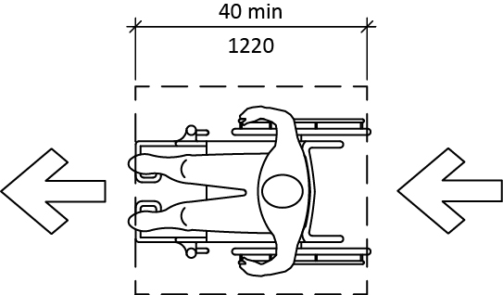
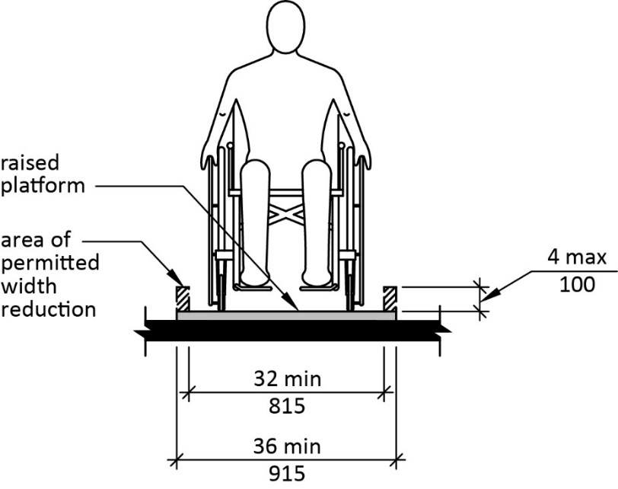
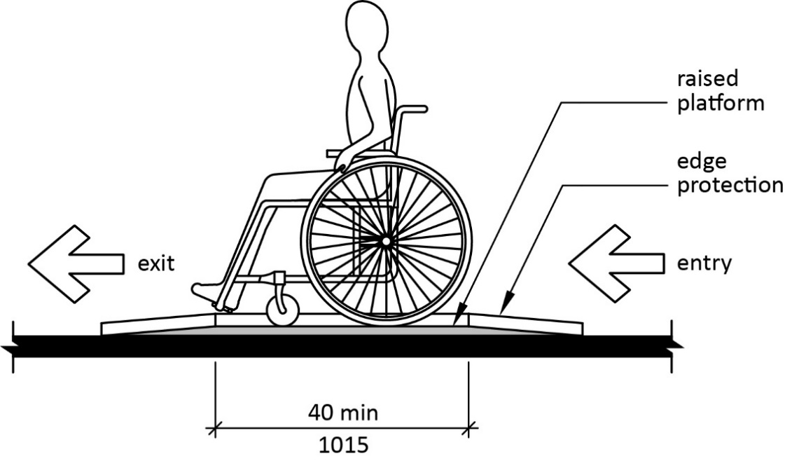
Wheelchair Spaces on Weight Scales - M303
Pass through entry depth and width exception address

Slide 59
Ramps Entries
Beveled change in level
Combination of height and
steep slope a barrier
Running slope Exception:
consistent with ADA Standards exception for rises of 3” or less in alterations, except max height is 2 ½”

Slide 60
Clearances beneath Components (M303)
Most MDE knee and toe clearance will be the same as ADA

Slide 61
Breast platforms
Height adjustable platform (M303.4.1)
continuously adjustable
low height of 26 inches
high height of 42 inches

Slide 62
Breast platforms
Clearances beneath Components (M303)
Knee clearance 17” deep min to allow user to bring chest in contact with platform
Knee and toe clearance allows additional obstruction under foot plates

Slide 63
Chapter 3
Supine, prone, or side-lying positions (M301)
Seated position (M302)
Seated in a wheelchair (M303)
Standing position (M304)
Supports (M305)
Communication (M306)
Operable parts (M307)

Slide 64
Standing Position (M304)
Slip resistant standing surface
Supports provided on two sides
Exception: Equipment with pass-through entry/exit can provide one horizontal support

Slide 65
Standing Supports – M305.3
Horizontal Supports:
On most equipment 4” min long
34” min. – 38” max.
Above standing surface to top
Vertical Supports:
18” min. long
34” min. - 37” max.
Above standing surface to lowest end of the gripping surface

Slide 66
Standing Supports (M305.3)
Horizontal Supports on weight scales with wheelchair spaces:
One entry – gripping surface along 80% of platform length
Pass- through:
Gripping surface equal to length of platform length
On one side only (M304.2.2 exception)

Slide 67
Chapter 3
Supine, prone, or side-lying positions (M301)
Seated position (M302)
Seated in a wheelchair (M303)
Standing position (M304)
Supports (M305)
Communication (M306)
Operable parts (M307)
PUSH

Slide 68
Transfer and Standing Supports
Structural strength
Not addressed like in ADA and ABA standards for grab bars
More variables
Industry standards address

Slide 69
M305 Supports
Transfer supports
Standing supports
Leg supports, stirrups
Head and back support

Slide 70
Supports
Leg supports – must provide a method of supporting, positioning, and securing the patient’s legs
Head and back support – Where equipment is used in a reclined position, head and back support shall be provided. Where the incline of the back support can be modified while in use, it must be provided throughout the entire range of the incline.

Slide 71
Transfer supports
Circular Cross Section
Outside diameter 1 ¼” min and 2” max
Similar to ADA grab bars in section 609
Free of sharp or abrasive components
Eased edges
Shall not rotate within their fittings
Non-circular Cross Section
Cross-section 2” max
Perimeter 4” min to 4.8” max

Slide 72
Transfer supports
Gripping surfaces
Continuous along their length and not obstructed on top or sides
No more than 20% of the length of the bottom of gripping services can be obstructed
1 ½” minimum clearance

Slide 73
Chapter 3
Supine, prone, or side-lying positions (M301)
Seated position (M302)
Seated in a wheelchair (M303)
Standing position (M304)
Supports (M305)
Communication (M306)
Operable parts (M307)
PUSH

Slide 74
Communication (M306)
Information Communicated through the equipment
Information provided in at least two methods:
audible
visible
tactile

Slide 75
Chapter 3
Supine, prone, or side-lying positions (M301)
Seated position (M302)
Seated in a wheelchair (M303)
Standing position (M304)
Supports (M305)
Communication (M306)
Operable parts (M307)
PUSH

Slide 76
Operable Parts (M307)
Only controls operated by the patient
Features addressed:
Tactilely Discernible
Operation
Operating Force

Slide 77
DOJ Guidance is Available
www.ada.gov

Slide 78
Final Standards
The final Standards for Accessible Medical Diagnostic Equipment can be found on www.access-board.gov under Healthcare, Medical Diagnostic Equipment

Slide 79
Guidance on Prescription Drug Container Labels

Slide 80
What Is a Prescription Drug Container Label
Legal Document
Universal Standard
U.S. Pharmacopeial Convention

Slide 81
Section 904 Of the Food and Drug Administration Safety and Innovation Act
§904. ACCESSIBILITY OF INFORMATION ON PRESCRIPTION DRUG CONTAINER LABELS BY VISUALLY-IMPAIRED AND BLIND CONSUMERS.
Establishment of Working Group
Develop “best practices” on access to information on prescription drug container labels for individuals who are blind or visually impaired.

Slide 82
Guidance on Prescription Drug Container Labels
(Advisory non-mandatory guidance)
Advisory guidance developed by a stakeholder working group provides best practices on providing access to prescription drug container labels for people who have vision impairments or who are elderly.

Slide 83
National Council on Disability (NCD)
Section 904 of the Food and Drug Administration Safety and Innovation Act
The law directed the National Council on Disability (NCD) to conduct an informational and educational campaign in cooperation with the stakeholder working group to inform the public, including people with disabilities and pharmacists, of the best practices.
https://ncd.gov/publications/2016/best-practices-accessible-prescription-drug-labeling
The law also called upon the Comptroller General to conduct a review to assess the extent to which pharmacies are implementing the best practices and to determine whether barriers to prescription drug labels remain.
https://www.gao.gov/products/GAO-17-115

Slide 84
Delivery Methods
Hard Copy Braille and Large Print
Digital Voice or Text to Speech Recorder
Radio Frequency Identification Device
Smart Devices and Computers

Slide 85
Best Practices Recommendations
Best Practices for All Formats
Communication
Provide options
Quality control
Maintain patient privacy
No Surcharge (extra fee)
www.access-board.gov/guidelines-and-standards/health-care/about-prescription-drug-container-labels/working-group-recommendations

Slide 86
Questions?

Slide 87
Contact info
TECHNICAL ASSISTANCE
(800) 872-2253
TTY: (800) 993-2822
mde@access-board.gov
or
ta@access-board.gov
www.access-board.gov
Bobby Stinnette
(202) 272-0021
stinnette@access-board.gov

Slide 88
Additional Resources
https://www.access-board.gov/guidelines-and-standards/health-care/about-this-rulemaking/final-standards/text-of-the-proposed-standards-8
https://adata.org/factsheet/accessible-medical-examination-tables-and-chairs
https://adata.org/factsheet/accessible-medical-diagnostic-equipment
https://www.ada.gov/medcare_mobility_ta/medcare_ta.htm
https://ncd.gov/publications/2016/best-practices-accessible-prescription-drug-labeling

Slide 89
Summary: Supine, prone, or side-lying position (examination tables)
When adjustable, head and back support provided throughout the entire range of the incline (M301.3.3)
Transfer support resists vertical and horizontal forces of 250 lbs. at all points and does not rotate within its fittings (M305.2.2 and M305.2.3) Rail serves as transfer support within reach of transfer surface (M301.3.1 and M305.2.1)
When provided, stirrups provide a method of supporting, positioning, and securing the patient’s leg (M301.3.2)
Support rail removable / repositioned to permit unobstructed transfer (M301.2.3 EXCEPTION)
Transfer surface 30 inches wide minimum and 15 inches deep minimum (M301.2.2)
One short side (depth) and one long side (width) of the transfer surface permit unobstructed transfer from a mobility device (M301.2.3)
6 inches high minimum clearance above finished floor where equipment overhangs clearance (M301.4.1)
Base permits clearance around base for a patient portable floor lift, see Figure M2 (M301.4 and M301.4.2
Transfer surface 17 inches minimum and 19 inches maximum above floor level (M301.2.1), when not needed to facilitate transfer, the transfer surface may be positioned above or below the height range (Advisory M301.2.1)

Slide 90
Summary: Seated position (examination chairs)
When adjustable, head and back support provided throughout the entire range of the incline (M302.3.3)
Transfer surface 21 inches wide minimum and 15 inches deep minimum (M302.2.2)
Armrest folds up to permit unobstructed transfer (M302.2.3 EXCEPTION)
Transfer surface 17 inches minimum and 19 inches maximum. Above floor (M302.2.1), when not needed to facilitate transfer, the transfer surface may be positioned above or below the height range (Advisory M302.2.1)
Required armrest serves as transfer support within reach of transfer surface (M302.3.1, M302.3.2, and M305.2.1)
Transfer support resists vertical and horizontal forces of 250 lbs. at all points and does not rotate within its fittings (M305.2.2 and M305.2.3)
One short side (depth) and one long side (width) of the transfer surface permit unobstructed transfer from a mobility device (M302.2.3)
Base permits clearance around base for a patient portable floor lift (M302.4 and M302.4.2)

